Slide 1
Routing Protocols (RIP, OSPF, BGP)

Slide 2
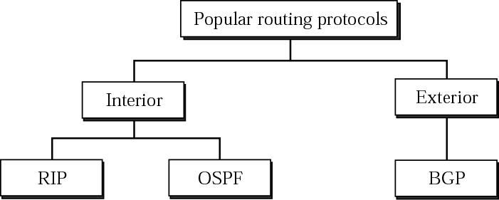
Popular routing protocols

Slide 3
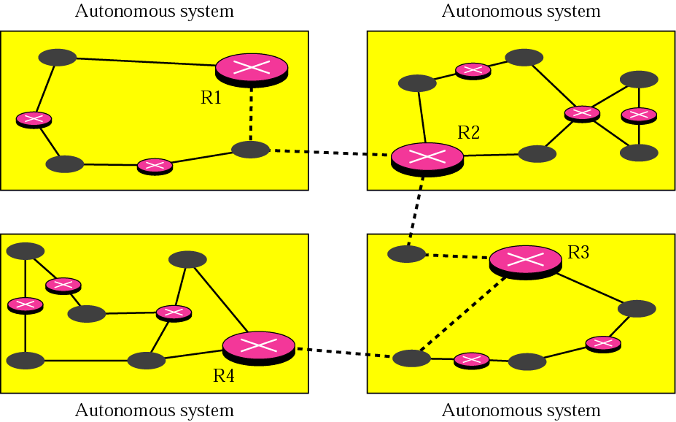
Autonomous systems

Slide 4
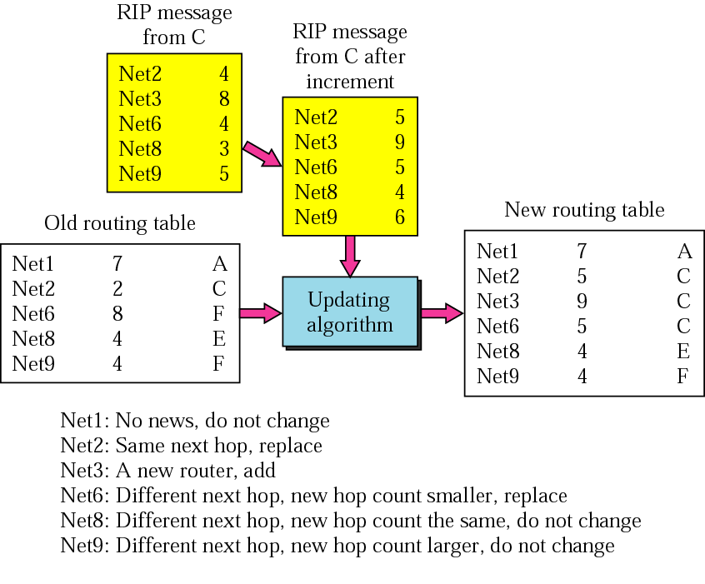
RIP:Routing Information Protocol (Example of updating a routing table)

Slide 5
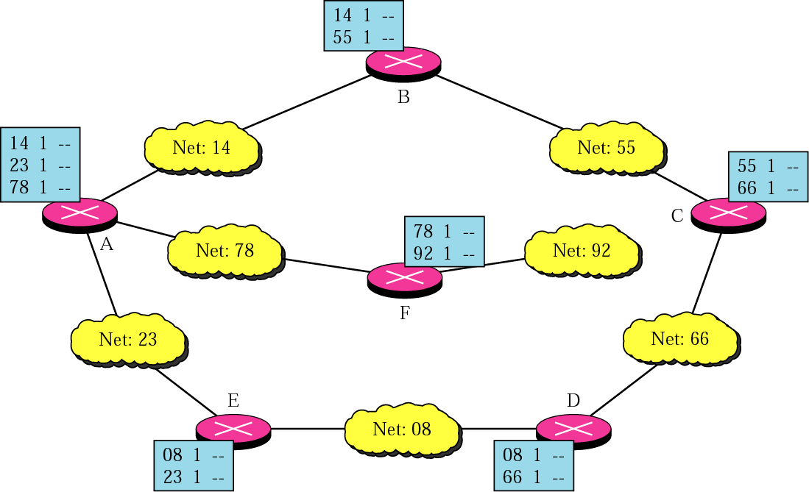
Initial routing tables in a small autonomous system

Slide 6
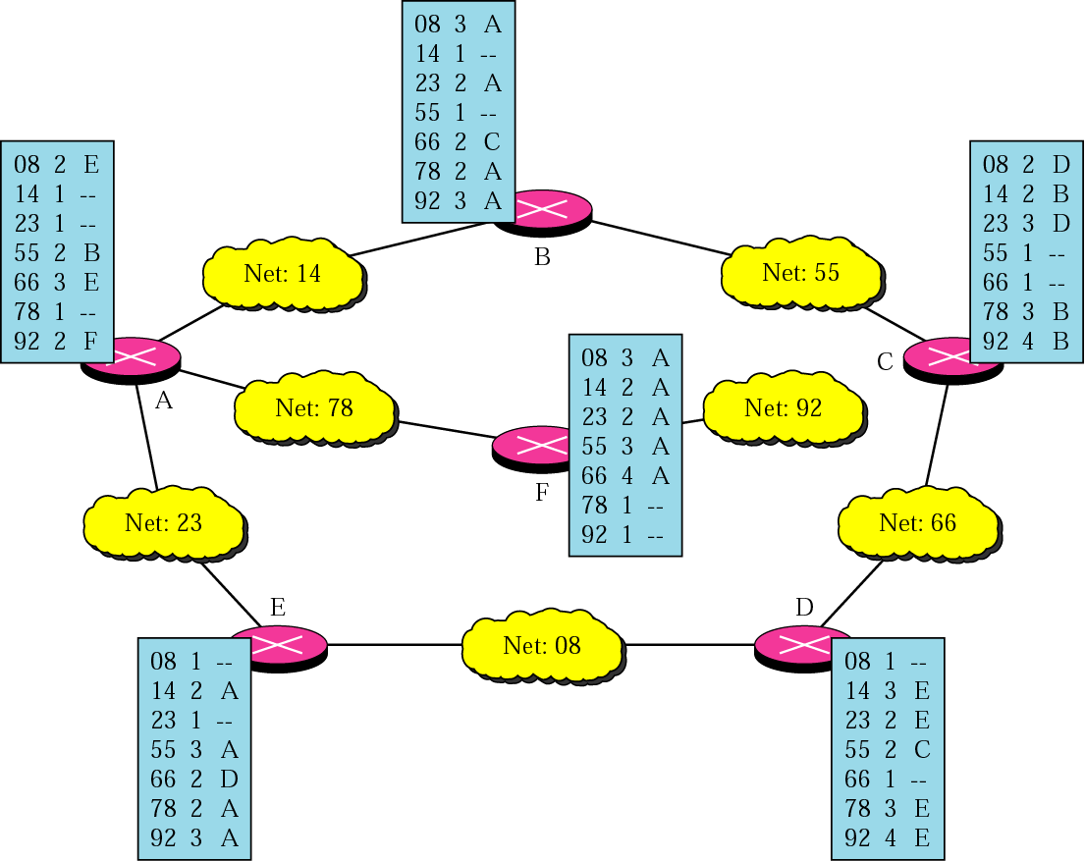
Final routing tables for the previous figure

Slide 7
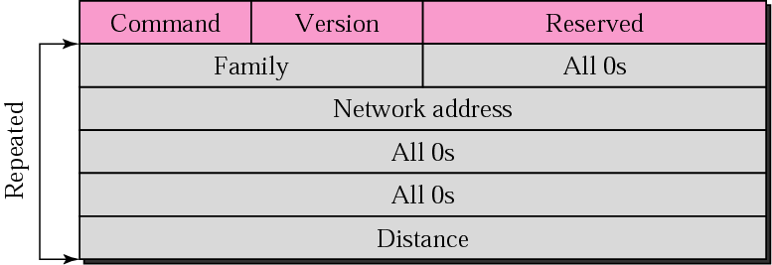
RIP message format

Slide 8
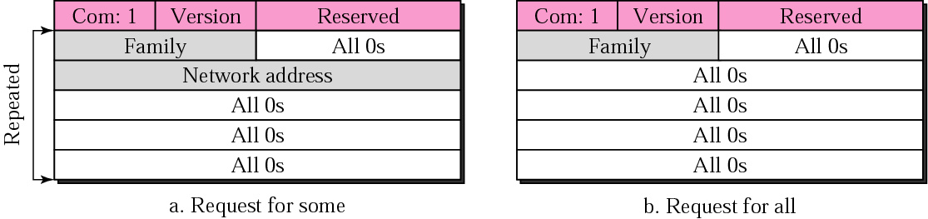
Request messages

Slide 9
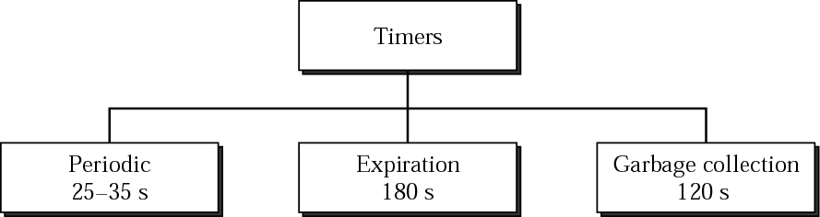
RIP timers

Slide 10
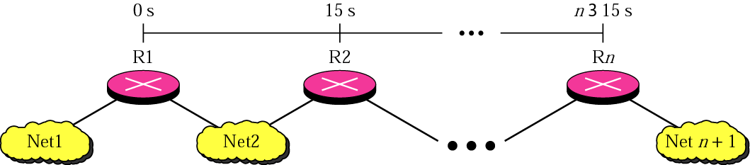
Slow convergence

Slide 11
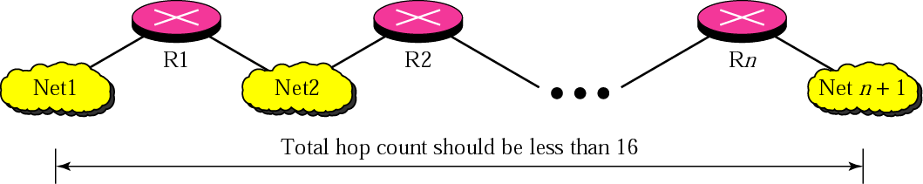
Hop count

Slide 12
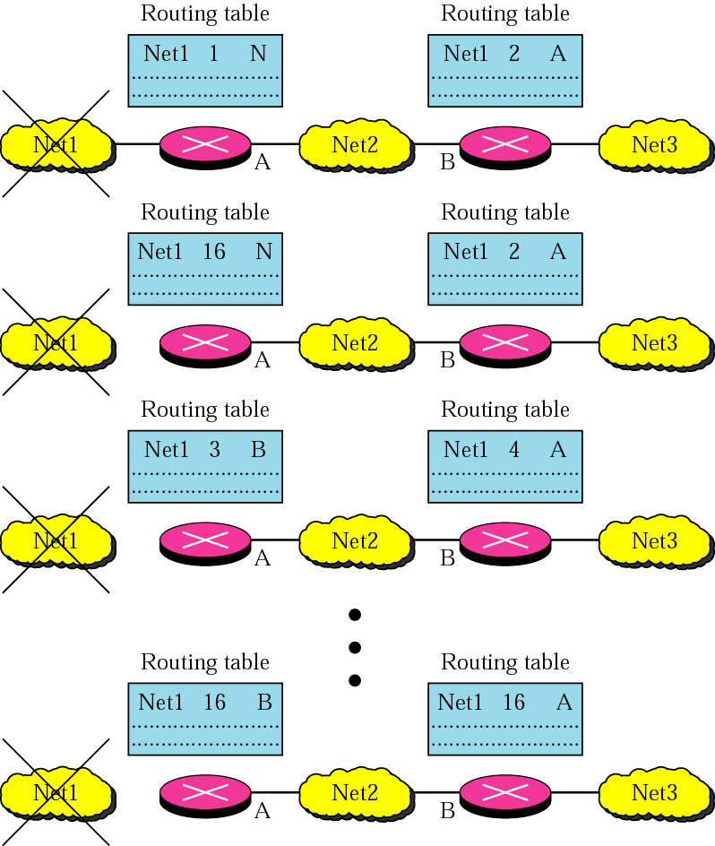
Instability

Slide 13
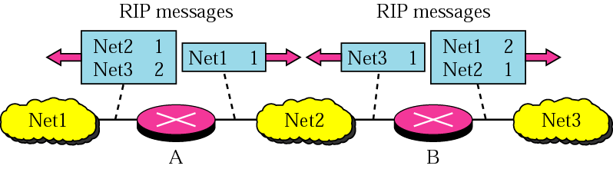
Split horizon

Slide 14
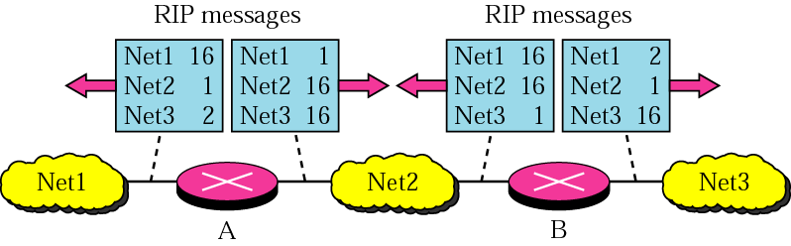
Poison reverse

Slide 15
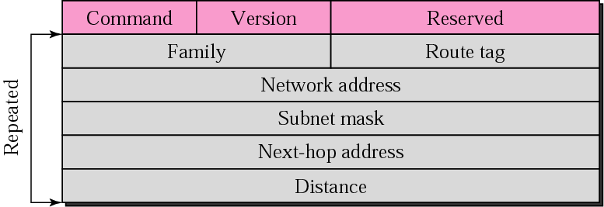
RIP-v2 Format

Slide 16
RIP uses the services of UDP on well-known port 520.

Slide 17
OSPF: Open Shortest Path First

Slide 18
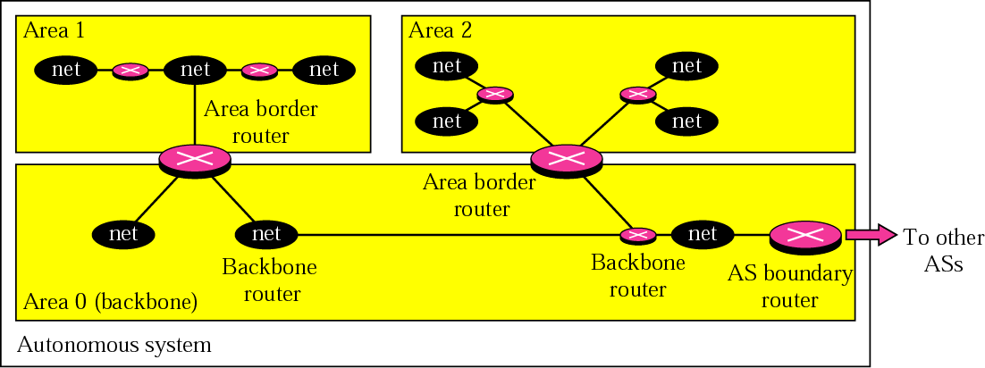
Areas in an autonomous system

Slide 19
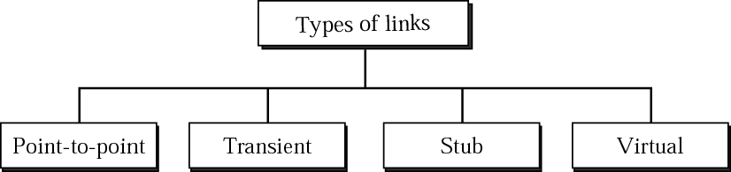
Types of links

Slide 20

Point-to-point link

Slide 21
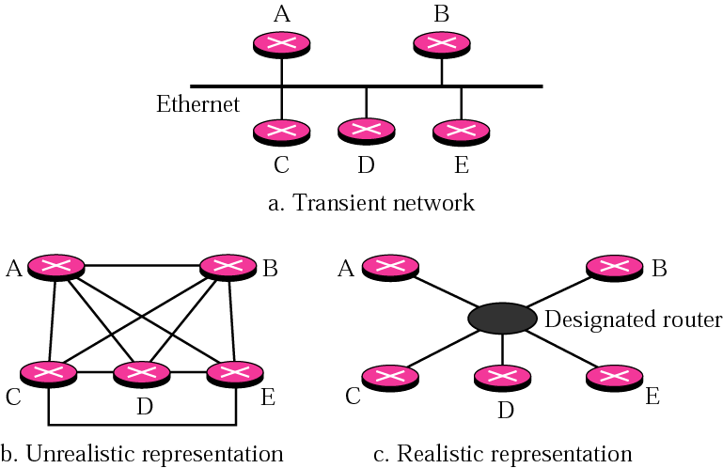
Transient link

Slide 22
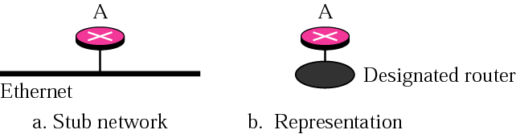
Stub link

Slide 23
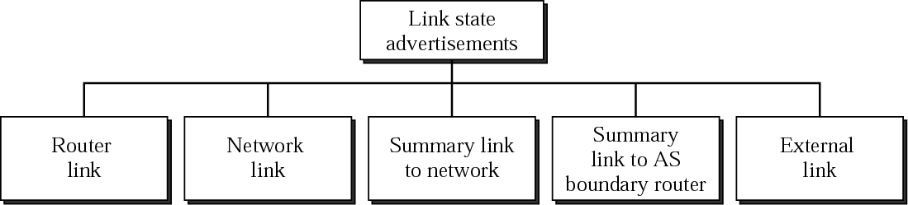
Types of LSAs

Slide 24
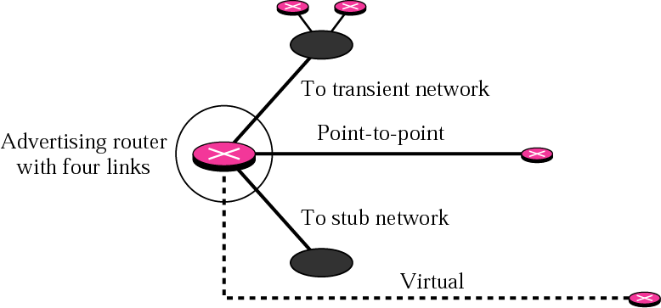
Router link

Slide 25
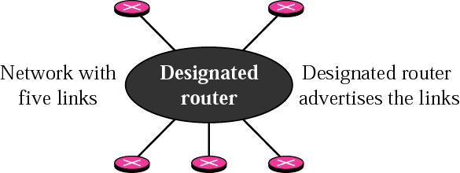
Network link

Slide 26
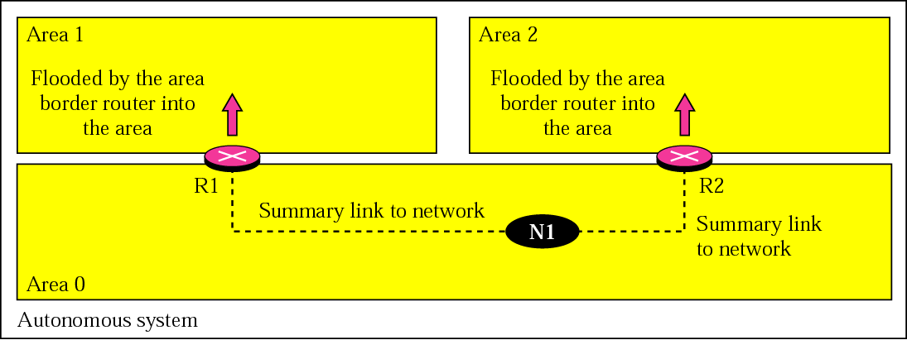
Summary link to network

Slide 27
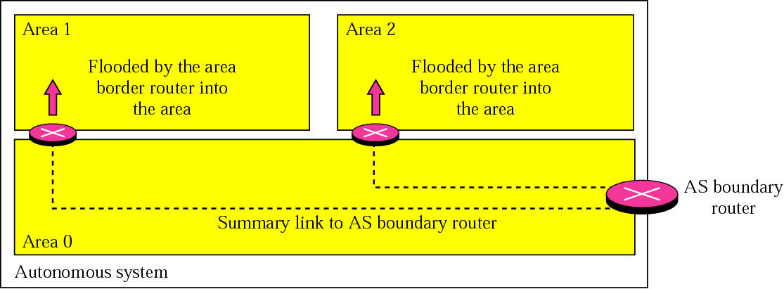
Summary link to AS boundary router

Slide 28
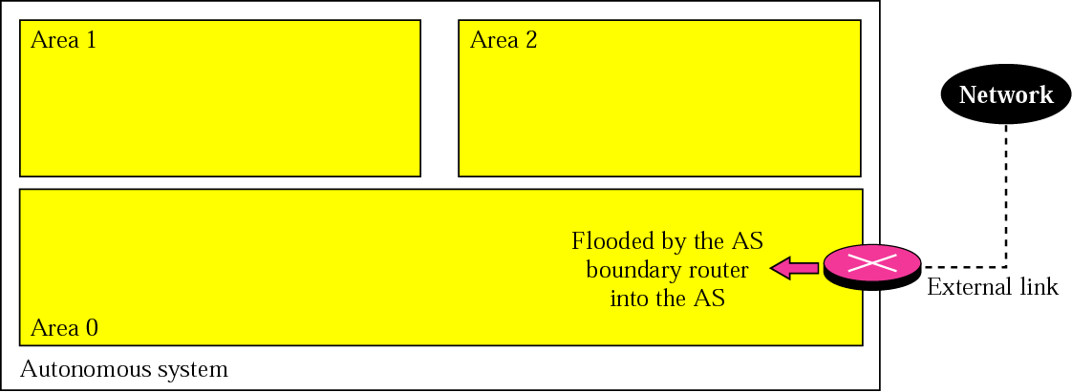
External link

Slide 29
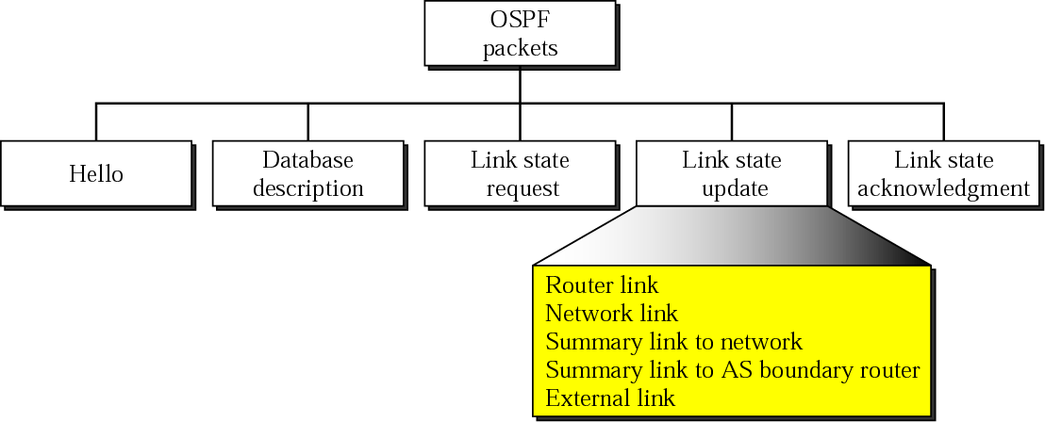
Types of OSPF packets

Slide 30
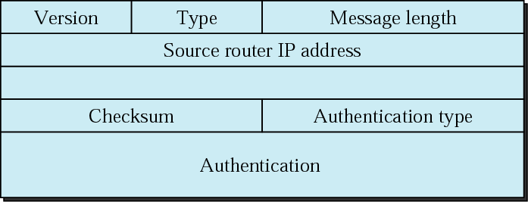
OSPF packet header

Slide 31
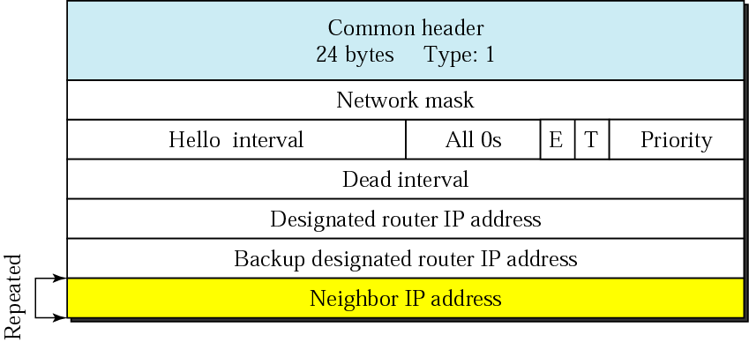
Hello packet

Slide 32
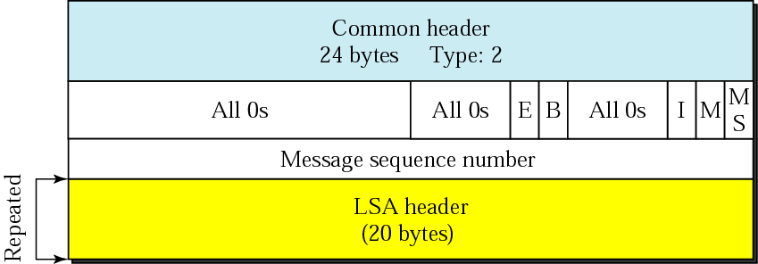
Database description packet

Slide 33
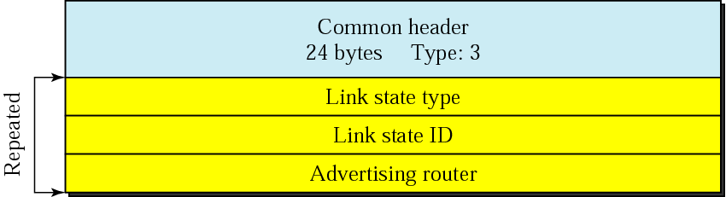
Link state request packet

Slide 34
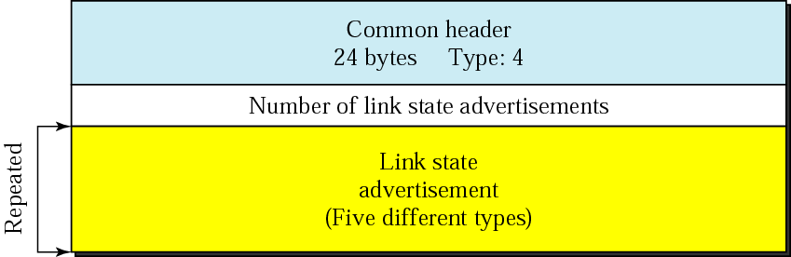
Link state update packet

Slide 35
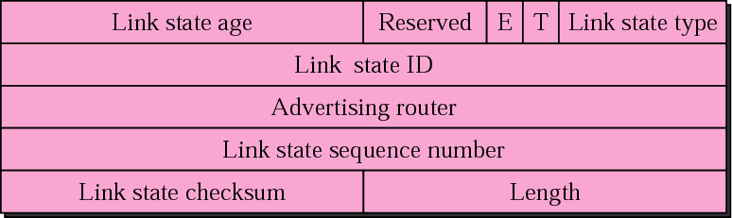
LSA header

Slide 36
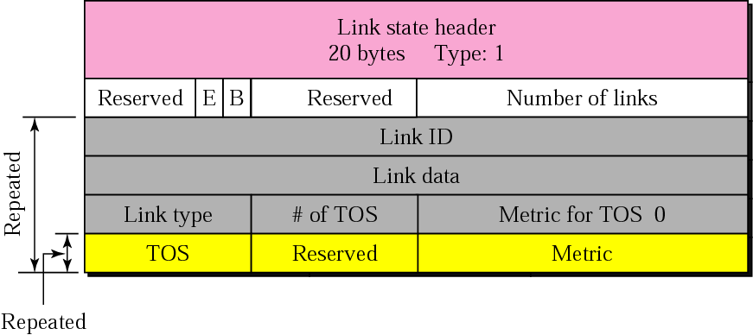
Router link LSA

Slide 37
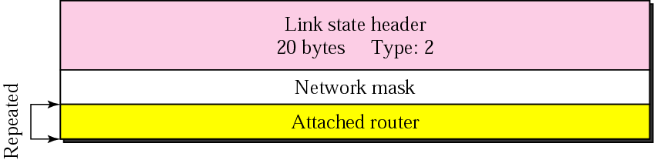
Network link advertisement format

Slide 38
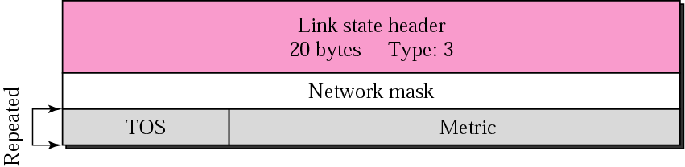
Summary link to network LSA

Slide 39

Summary link to AS boundary LSA

Slide 40
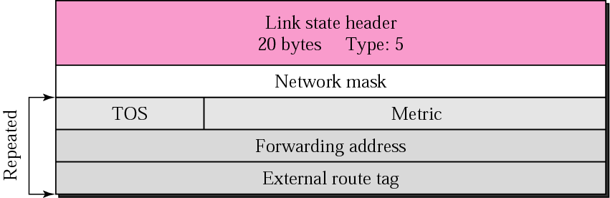
External link LSA

Slide 41

Link state acknowledgment packet

Slide 42
OSPF packets are encapsulated in IP datagrams.

Slide 43
BGP(Border Gateway Protocol)

Slide 44
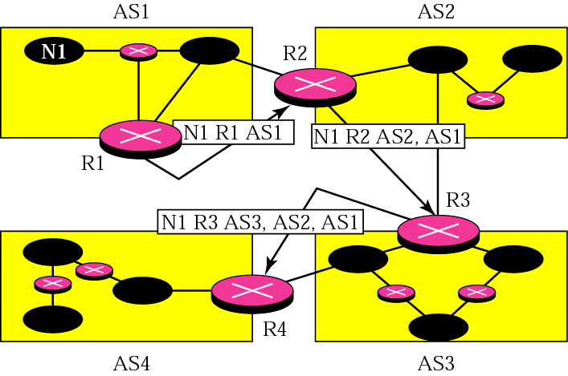
Path vector packets

Slide 45
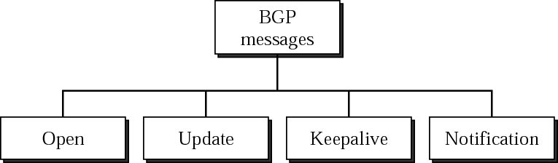
Types of BGP messages

Slide 46
BGP supports classless addressing and CIDR.

Slide 47
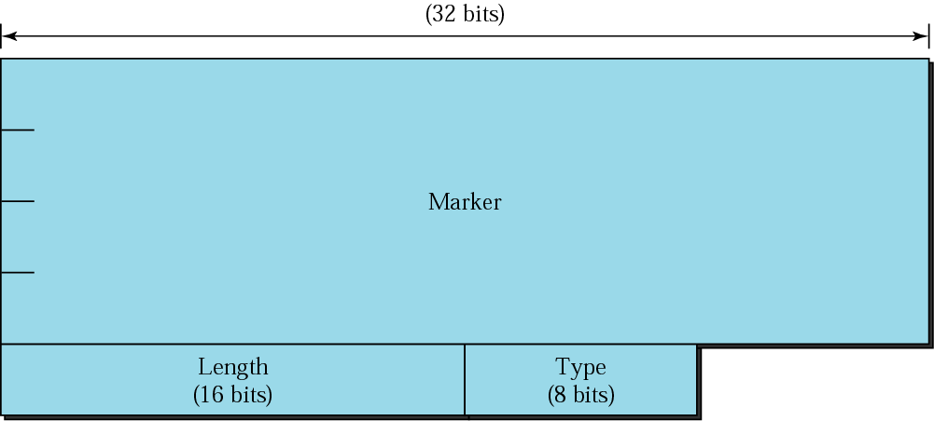
BGP packet header

Slide 48
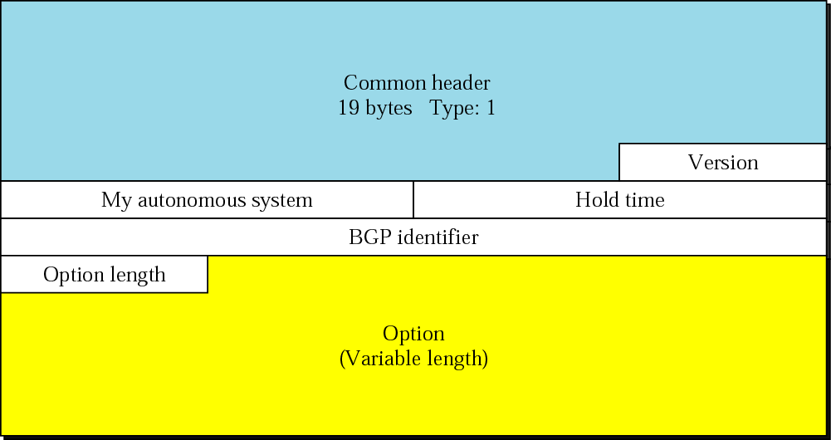
Open message

Slide 49
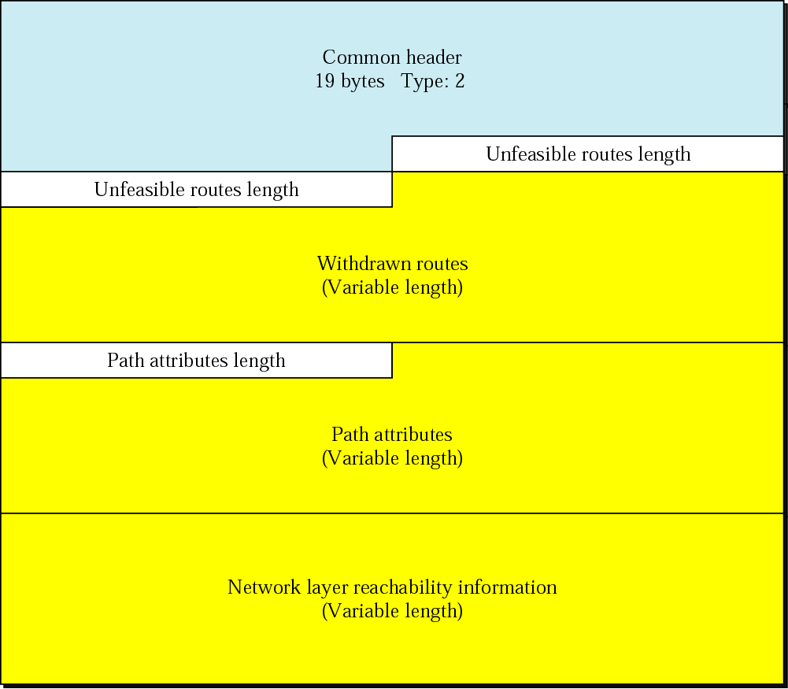
Update Message

Slide 50

Keepalive message

Slide 51
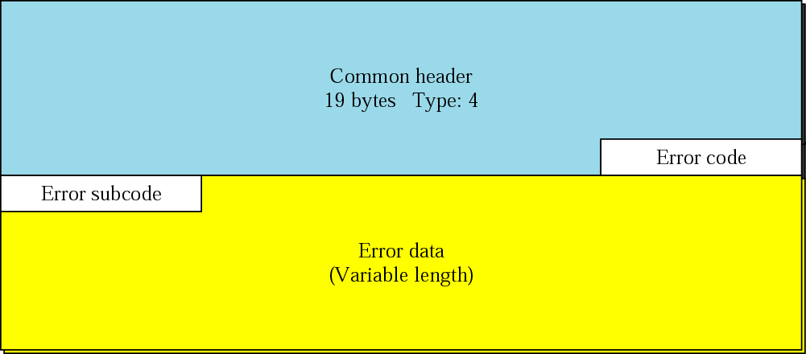
Notification message

Slide 52
BGP uses the services of TCP on port 179.

